Slide 1
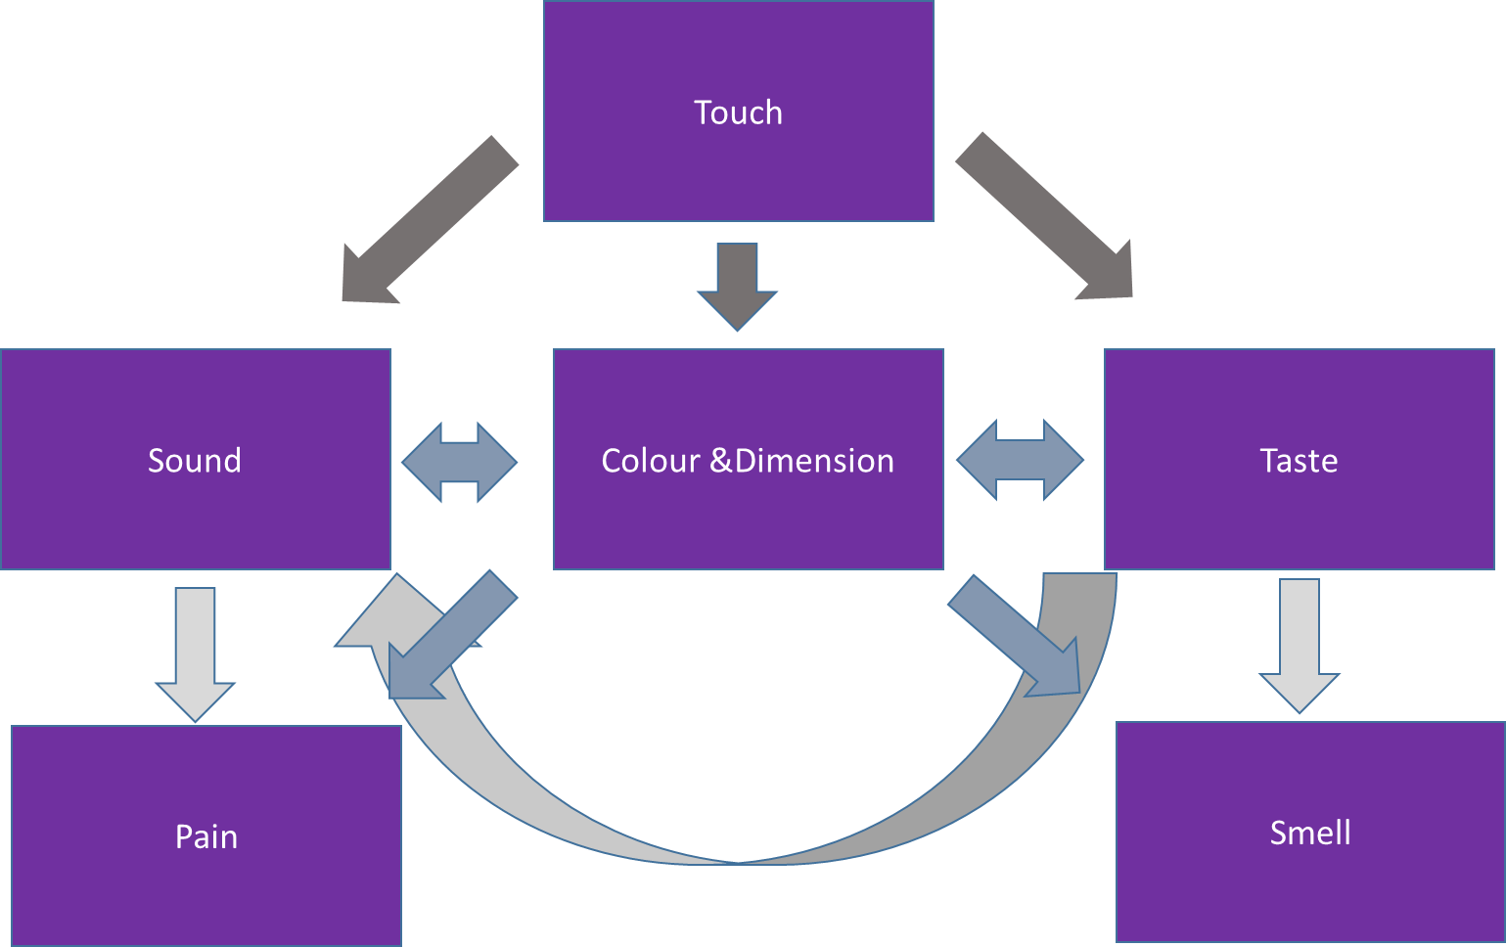
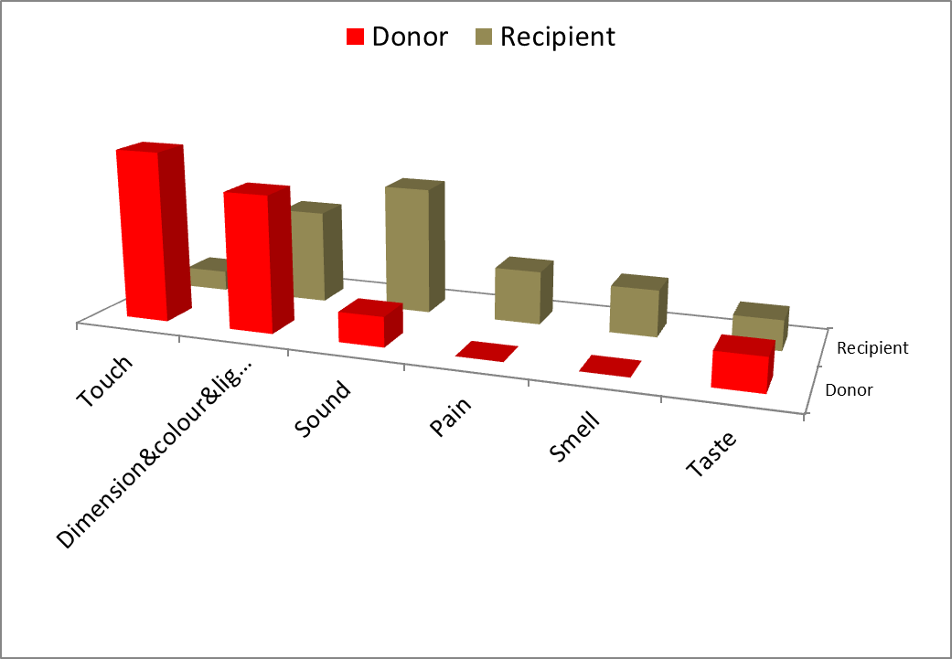
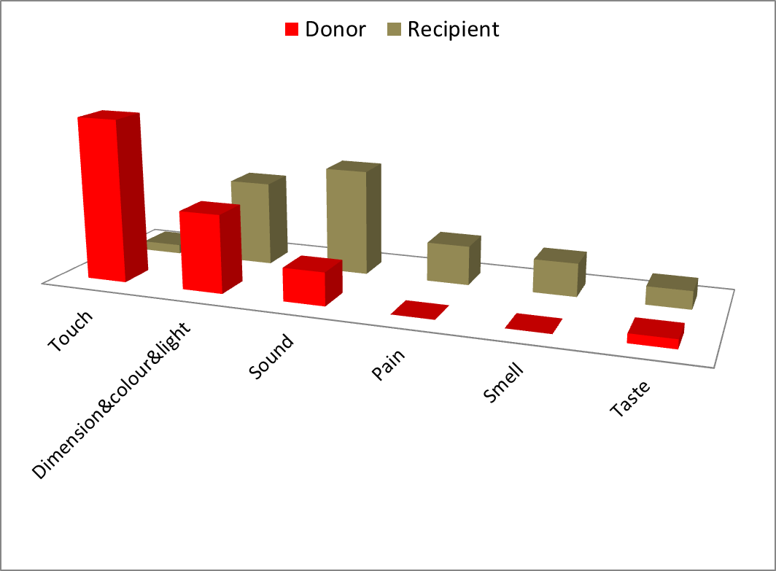
SYNAESTHETIC METAPHORS IN THE RUSSIAN AND ITALIAN LANGUAGES: A COMPARATIVE STUDY GeorgIy Blinnikov, Moscow State Linguistic University
Introduction
The fact that sensory qualities, the basis of human perception, are hard to interpret (What is bright? What is sweet?) has always intrigued philosophers, psychologists, and linguists.
Another intriguing fact is the ability of many sensory qualities to produce meanings that describe qualities from other sensory zones (e.g. rovnyj zvuk [flat sound] vision → hearing). Such transfers were named synaesthetic after a neurological phenomenon, called synaesthesia, in which stimulation of one sense leads not only to its inherent sensations, but to sensations in another sense, as well.
Scientists who dealt with the linguistic problem of synaesthetic transfers suggested various models for emerging linguistic phenomena patterns. Ullmann (1951) divided sensory adjectives into six groups according to their type or receptors (vision, hearing, touch, taste, smell and temperature) and studied their synaesthetic transfers in the nineteenth century poets’ works. He found the following pattern: adjectives connected with the less differentiated sensations tend to be the source for the meanings connected with the more differentiated ones, and not vice versa. Henceforth, touch is the main source for transfers and hearing is their main target. At the same time, he found a high correlation between tactile and temperature sensations, as well as between taste and smell. Williams (1976) employs a diachronic approach taking cited meanings of sensory adjectives (65 units) in English dictionaries (like the Oxford English Dictionary). Unlike Ullmann Williams doesn’t isolate temperature qualities, but he splits vision into two zones: Colour&Light and Dimension. He constructed a graph (fig.1) where arrows show the diachronic transfer direction. The shown patterns match Ullmann’s predictions, although some exceptions are found, as well.
Fig.2 shows a quantitive analysis of synaesthetic transfers in the Italian and Russian languages. The first column shows the total number of studied adjectives and, after a comma, the number of metaphor-productive adjectives for each sensor. Each Y axis line shows the number of transfers donated by the sensor to other sensors, while each X axis column shows the number of transfers received by the sensor from other sensors. The last column shows the total number of metaphors produced by each sensor and the last line shows the total number of metaphors received by each sensor. A figure before a slash shows the Italian data, while a figure after a slash shows the Russian data.
The languages showed similarities on the lexeme level, too. The list of the most productive adjectives in both languages is almost identical: acuto, ostryi ‘acute’, leggero, lyogkiy ‘light’, pesante, tyazhelyi ‘heavy’, duro, zhostkiy ‘hard’, morbido, myagkiy ‘soft’, tenero, nezhnyi ‘tender’ in both languages и dolce ‘sweet’ only in Italian. These adjectives account for 36 synaesthetic meanings in Italian and 33 meanings in Russian. The Russian lexeme yarkiy ‘bright’ is of interest as it produces three figurative meanings and doesn’t have an analogue in the Italian language.
In order to compare our results with other studies the used zones were united into the groups corresponding to the traditional senses (with Pain). Fig.6 shows the direction of synaesthetic transfers.
The diagram confirms almost all patterns predicted by Ullmann and Williams, however, Vision Zone donates metaphors to Taste Zone, contrary to Williams’ hierarchy (thanks to the Russian lexemes yarkiy ‘bright’ and yasnyi ‘clear’ and the Italian adjective chiaro ‘clear’). Other deviations are sporadic and are found only in one language and hence can be treated as exceptions. In particular, the adjective dolce ‘sweet’ in Italian can denote pain and tactile sensations, and the adjective arguto ‘shrill’ can denote gustatory and olfactory ones (another proof that we deal with an exception here is that its historically first meaning was ‘acute’)
Sensor Total number of adjectives, metaphor-productive adjectives | Dimension | Colour | Sound | Taste | Smell | Tactile | Weight | Temperature | Pain | Total
Italian/Russian | I/R | I/R | I/R | I/R | I/R | I/R | I/R | I/R | I/R | I/R
Dimension 39,17/31,13 | х | 5/3 | 16/8 | 2/1 | 2/2 | - | - | - | 3/2 | 28/16
Colour 53,12/48,12 | - | х | 10/4 | 1/2 | 0/1 | - | - | - | 1/2 | 13/9
Sound 42,6/43,8 | - | 4/4 | х | 1/0 | 1/0 | - | - | - | 3/4 | 9/8
Taste 33,6/25,9 | - | 0/1 | 1/2 | х | 6/0 | 1/0 | - | 1/0 | 1/0 | 10/3
Smell 15, 0/17,0 | - | - | - | - | х | - | - | - | 0 | 0
Tactile 78, 25/ 62,19 | 7/5 | 6/4 | 7/12 | 5/0 | 3/5 | х | - | 4/2 | 2/2 | 34/30
Weight 6,4/ 12,4 | 1/0 | 1/4 | 2/3 | 0/3 | 2/3 | - | х | - | 5/3 | 11/16
Temperature 12,7/23,8 | - | 4/7 | 1/0 | - | - | 0/1 | - | х | 1/0 | 6/8
Pain 5,0/5,0 | - | - | - | - | - | - | - | - | х | 0/0
All sensors 283, 77/266,73 | 8/5 | 20/23 | 38/29 | 9/6 | 14/11 | 1/1 | 0/0 | 5/2 | 16/13 | 111/90
Fig. 2. Total estimate of all synaesthetic transfers
Italian language
77 out of 283 adjectives produce synaesthetic metaphors (27.2%). Dimension Zone has the highest number (in respect to the total number of the zone adjectives) of adjectives that are able to create figurative meanings (43.5%). Neither Smell Zone adjectives, nor Pain Zone adjectives produce synaesthetic metaphors.
Touch Zone (34 units or 30.6%) and Dimension Zone (28 units or 25.2%) are the main donor zones, Sound Zone is the main recipient zone (38 units or 34.2%).Temperature and Taste Zones receive roughly as many metaphors as they produce. Colour Zone produces more than it receives and Kinaesthetic Zone doesn’t possess any target meanings .
Fig.1 Williams’ generalization
Fig.6. Direction of synaesthetic transfers.
Factor analysis was employed to investigate the relationship between sensory zones in Russian and Italian (fig.7). It confirmed a) relevancy of donation-reception factor and b) proximity of patterns in the Russian and Italian languages.
In the course of the analysis two factors stood out that accounted for 72.83% of the total dispersion. The first factor (which accounted for 44.68 of the dispersion), included such zones as taste (0.900), touch (0.876), colour (0.851), dimension (0.850) and temperature (0.776) which are primarily donors, while the second factor (which accounted for 28.15% of the dispersion) included Sound (0.853), taste (0.833) and pain (0.734) which are recipient zones. Weight Zone was included in both factors.
A similar pattern was suggested by Stepanyan (1987), who studied Russian synaesthetic adjective transfers in Russian fiction literature. He established that intermodal metaphors were formed by 87% of tactile adjectives, 88% of gustatory adjectives, 35% of olfactory adjectives, 16% of auditory and 7.7% of colour ones. Thus, the more advanced senses produce a lower number of synaesthetic metaphors, than the more primitive ones.
It’s worth noting that the given hierarchy doesn’t function if other parts of speech become the research subject. Viberg (1983) set forth an opposite sequence of sensory modalities: vision > hearing > touch > taste/smell. In other words, verbs of visual perception can be used to denote qualities of the following sensory modalities, while verbs of taste and smell cannot denote qualities of the previous senses.
Research
For this study 282 sensory Italian adjectives and 266 sensory Russian adjectives were selected, and their synaesthetic metaphors were analysed. If earlier research was carried out with the help of dictionaries and literature, today we can resort to new instruments, such as text corpora that allow getting an almost adequate picture of modern language usage. This study used glossaries (such as the Treccani Dictionary for Italian and the Small Academy Dictionary for Russian) and text corpora (Corpus Coris for Italian and the Russian National Corpus for Russian). The first cited meaning in the dictionary was used as the source meaning, a metaphorical meaning found in dictionaries or corpora was used as the target meaning. A detailed sensation categorization was employed: following Williams, Vision Zone was divided into Colour Zone and Dimension Zone, Touch Zone was split into Tactile, Temperature and Kinaesthetic (Weight) Zone. Pain sensations also formed a separate zone. Only established synaesthetic transfers were studied. In the course of the research, the following subtypes of synaesthesia were determined.
Subtype A. Pseudosynaesthesia
A researcher could be tempted to treat phrases like ‘flat surface’ as a synaesthesia between touch and vision, or vision and touch (depending on what sense this quality is primarily attached to), but in fact, qualities like this are just perceived by more than one sense and there is no transfer.
Subtype B. Metonymy
Certain qualities of an object can be directly connected to other qualities of this object. For example, the phrase ‘a heavy rumble of wheels’ can be restated as ‘a rumble of heavy wheels’, i.e. the weight of the wheels, their property of being ‘heavy’, defines the sound which they make. In this case, we deal with a metonymy, not with a metaphor. However, the metonymy of this kind usually further develops into a full metaphor losing its connection with other qualities of the denoted object.
Subtype C. Emotional metaphor.
Emotional metaphors constitute a separate subtype as they don’t denote physical qualities but emotions. Touching, gesticulation, expression of the face and eyes and, particularly, the voice are human communication channels where the respective senses (touch, vision, and hearing) serve as gateways. As these channels can transfer emotions, the latter can be attributed to the channel itself (speech) or to the communication source (glance), which makes phrases like mrachnaja rech [rus] ‘gloomy speech’ or sguardo amaro [it] ‘bitter glance’ possible.
Subtype D. Intensifiers
The adjectives lyogkiy, leggero ‘light’, tyazhelyi, pesante ‘heavy’, vysokiy, alto ‘high’, nizkiy, basso ‘low’, bolshoy, grande ‘big’, malenkiy, piccolo ‘little’, when combined with certain nouns, intensify qualities denoted by these nouns. The metaphors of this type presuppose that, first, the adjective loses its primary meaning and becomes an intensifier and then it modifies the meaning (from another modality) of the noun it is combined with.
Subtype E. Pure metaphor
A transfer that is carried out directly between two physical qualities that belong to different sensory zones (priglushennyi svet [rus] ‘muffled light’, sapore acuto [it] ‘acute taste’).
Transfers that create a relative meaning in the target zone (legkaya muzyka ‘light music’, voce bianca ‘white [female] voice’) were not taken into account in the research as relative meanings can be considered sensory ones only at first sight. In the first place, they show the relation of an object to a certain class (a female voice, not a male one; light music, not heavy music).
Fig. 3. Total number of produced and received metaphors for each sensor in the Italian language
Russian language
73 out of 266 adjectives produce synaesthetic metaphors (27.4%). As in Italian, Dimension Zone has the highest number (in respect to the total number of the zone adjectives) of adjectives that are able to create figurative meanings (41.9%). Neither Smell Zone adjectives, nor Pain Zone adjectives produce synaesthetic metaphors as is also the case with Italian. Touch Zone (30 units or 31.9%) is the main donor zone with Dimension Zone (19 units or 20.2%) and Weight Zone (16 units or 17%) close to it. Sound Zone (29 units or 30.8%) and Colour Zone (23 units or 24.4%) are the main recipient zones. As in Italian, Temperature and Taste Zones receive roughly as many metaphors as they produce. Taste Zone receives more than it produces and Temperature Zone receives less than it produces.
Fig.7. Factor analysis output
Other synaesthetic types
If we add other subtypes of synaesthesia, such as emotional metaphors and intensifiers we will see some violations of Williams’ hierarchy. For example, transfers from Taste Zone into Touch and Vision Zones become possible (high emotionality of gustatory sensations seems to be the reason).
Conclusions
The case study of the Italian and Russian languages on the whole confirms the synaesthetic transfer patterns predicted by Ullmann and Williams. The idea of Lakoff and Johnson that simple, physical experience is the basis for complicated, cognitive metaphors could be an explanation. If we take physical experience alone, more primitive sensory qualities tend to become the source for transfers into more complex sensory zones. On the other hand, a high number of transfers into Smell and Pain Zones shows that the zones that lack their ‘own’ adjectives (and whose qualities are hard to verbalise) have to borrow them from other sensory zones. Similarities between the languages under study can be explained by the fact that they belong to the same cultural and linguistic area (the so-called Standard Average European), although Russian is not in its core. Data from other language families and linguistic areas are necessary to prove or disprove that the given hierarchy is not culturally determined, but it is a universal human feature.
Fig. 4. Total number of produced and received metaphors for each sensor in the Russian language
Italian and Russian compared
Despite minor differences between the Italian and Russian languages, which show up in individual cells of the table, transfer directions and numerical data are generally the same in both languages. Pain and Smell Zones don’t produce metaphors, while Weight Zone doesn’t receive them. Touch Zone is the main donor zone and Sound Zone is the main recipient zone. A close number of metaphor-productive adjectives in both languages is also of interest (77 in Italian and 73 in Russian). Nevertheless, some differences were found: Dimension Zone in Italian donates much more meanings in Italian than in Russian, and Russian Weight Zone is more productive than the equivalent Italian zone.
Themes for future research
The main trend of the future research is the study of languages belonging to other language families and cultural areas. A study of borrowings of synaesthetic metaphors could be also important, in this respect. The study of potential metaphors that haven’t become part of language usage but are considered possible by language speakers can be another theme.
 |  | Dimension | Colour &Light | Sound | Taste | Smell | Touch | Weight | Temperature | Pain
RUSSIAN | Donor | 16 | 10 | 8 | 3 | 0 | 30 | 16 | 8 | 0
 | Recipient | 5 | 23 | 29 | 6 | 11 | 1 | 0 | 2 | 13
ITALIAN | Donor | 28 | 13 | 9 | 10 | 0 | 34 | 11 | 6 | 0
 | Recipient | 8 | 20 | 38 | 9 | 14 | 1 | 0 | 5 | 16
References
1.Ullmann, Stephen 1951. The Principles of Semantics.Glasgow:Jackson, Son & Company.
2. Viberg, Ake1983. “The verbs of perception: a typological study.”Linguistics 21, 123-162.
3. Williams, Joseph M. 1976. “SynaestheticAdjectives: A Possible Law of Semantic Change.”Language 52(2), 461-478.
4. Stepanyan, Т. 1987. Sinesteticheskie metafory russkogo yazyka: prilagatelnye chuvstvennogo vospriyatiya”. PhD Thesis.
5. Corpus Coris // URL: http://dslo.unibo.it/coris_eng.html.
6. Russian National Corpus http://www.ruscorpora.ru/en/index.html
7. L’enciclopedia italiana // URL: http://www.treccani.it/
8. Small Academy Dictionary. 1981-1984. Evgen’eva A. Moscow: Russkiy yazyk.
Fig. 5. Total number of produced and received metaphors for each sensor in the Russian and Italian languages

